Slide 1

PRESENTATION
JOB SATISFACTION FACTORS AMONG DATA SCIENCE DEVELOPER
NAME: AISAR NASRUN BIN RAMJEE
MATRIC NO.: 2216791
15 JUNE, 2025

Slide 2
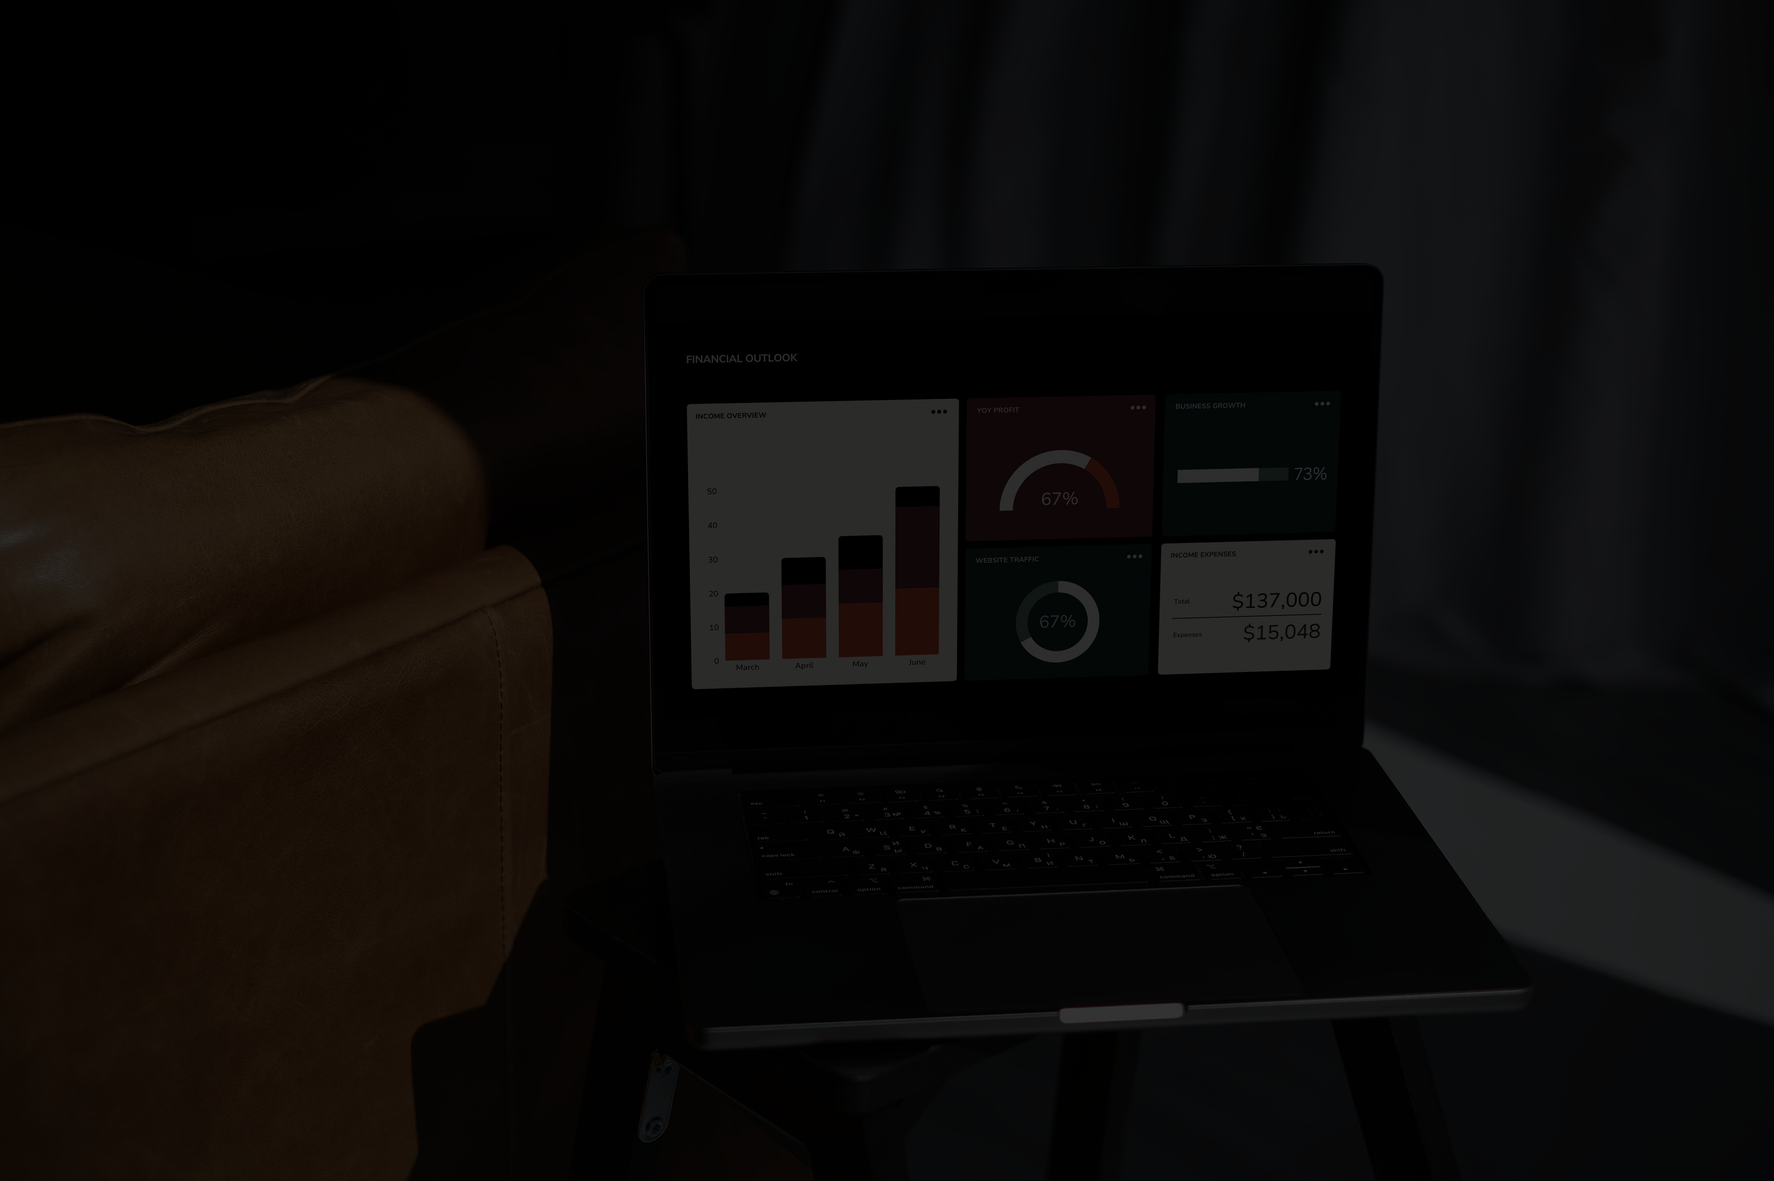
OVERALL SUMMARY
2216791
The analysis shows that job satisfaction among data science developers is shaped by a combination of factors rather than one single influence. Developers in hands-on technical roles like data scientists and engineers tend to report higher satisfaction, while those in academic or research-heavy positions often feel less fulfilled. Interestingly, higher salaries do not always lead to greater satisfaction. Many developers earning average or even below-average pay still express contentment with their jobs, suggesting that compensation is not the main driver of happiness. A supportive work environment makes a significant difference. Flexibility in scheduling, the option to work remotely, and a positive company culture are all strongly linked to higher job satisfaction. In contrast, rigid structures, toxic environments, and lack of support from leadership contribute to dissatisfaction. Trust in managers and the ability to work independently are key factors, while job titles or financial rewards play a lesser role. To truly improve satisfaction among data science professionals, organizations should focus on flexibility, empowering leadership, and fostering a healthy work culture.

Slide 3
BACKGROUND
2216791
The background of this analysis stems from growing interest in understanding what drives job satisfaction among data science professionals. As the field expands rapidly, companies face challenges not only in hiring but also in retaining skilled developers. While compensation and job roles are commonly considered, there is increasing recognition that workplace culture, management quality, and work-life balance may play a larger role than previously assumed. By examining real-world survey data from those in the data science and development field, this study aims to uncover patterns and insights that go beyond surface-level assumptions. It sets the foundation for identifying which factors truly matter to employees and how organizations can adapt to meet evolving professional expectations.

Slide 4

DATA SCIENCE QUESTIONS
2216791
1. Management Factors
How does confidence in a manager affect job satisfaction?
Are employees who trust their managers more satisfied regardless of pay?
Is the desire for a manager linked to satisfaction or independence?
2. Work Environment
Does remote work frequency impact job satisfaction?
Do flexible work plans lead to higher satisfaction?
How does the presence of dependents affect work-life balance and job satisfaction?
3. Compensation & Hours
Is there a direct correlation between monthly compensation and job satisfaction?
Do longer work hours reduce satisfaction?
Does compensation matter more for dissatisfied workers?
4. Role & Motivation
Which developer roles report the highest satisfaction?
Do people motivated by money report lower satisfaction if leadership is weak?
Are researchers less satisfied than industry data scientists?

Slide 5

OBJECTIVE
2216791
To analyze key factors influencing job satisfaction among data science professionals
To compare the impact of management quality, work environment, compensation, and job roles
To identify which workplace conditions are most strongly associated with high or low satisfaction
To provide insights for organizations aiming to improve retention and well-being in data team

Slide 6

METHODOLOGY
2216791
Dataset sourced from developer survey focused on job roles, satisfaction, and workplace factors
Data cleaning and transformation done using PySpark for scalability and handling nulls
Exploratory analysis and visualizations performed in Pandas, Seaborn, and Matplotlib
Grouped analysis by categories: Management, Environment, Compensation, Role
Correlations and stacked bar charts used to identify patterns and key influencers of satisfaction

Slide 7

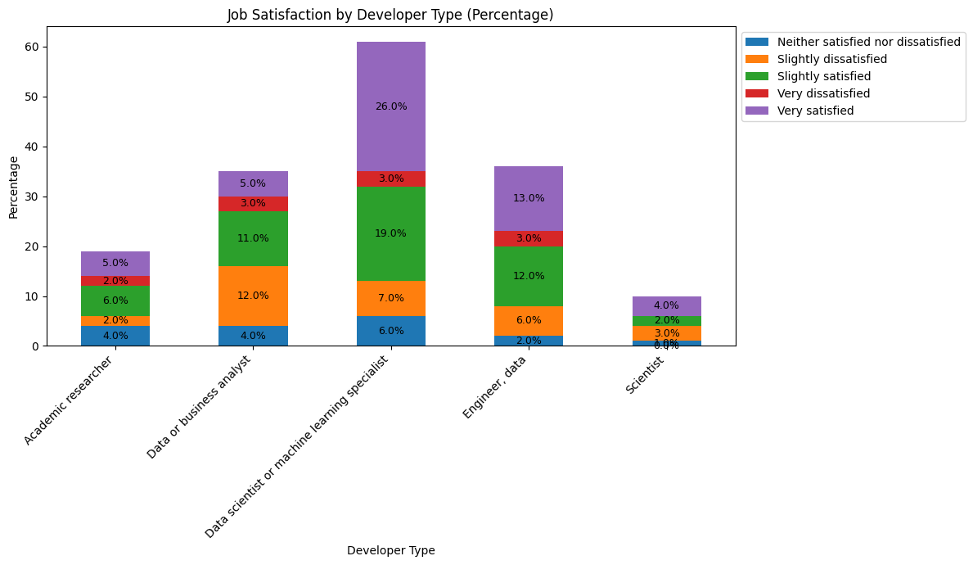
RESULTS
2216791
JOB RELATED FACTORS
Data science and engineering roles, particularly Data Scientists and Machine Learning Specialists, report high job satisfaction, with 19% very satisfied and 7% slightly satisfied. Engineers/Data also show a positive outlook, with 13% very satisfied and 12% slightly satisfied. In contrast, Academic Researchers and Scientists have much lower satisfaction levels, with many respondents feeling neutral or dissatisfied. Overall, technical roles in data science and engineering tend to have higher satisfaction, while academic and scientific roles see more mixed or lower satisfaction.

Slide 8
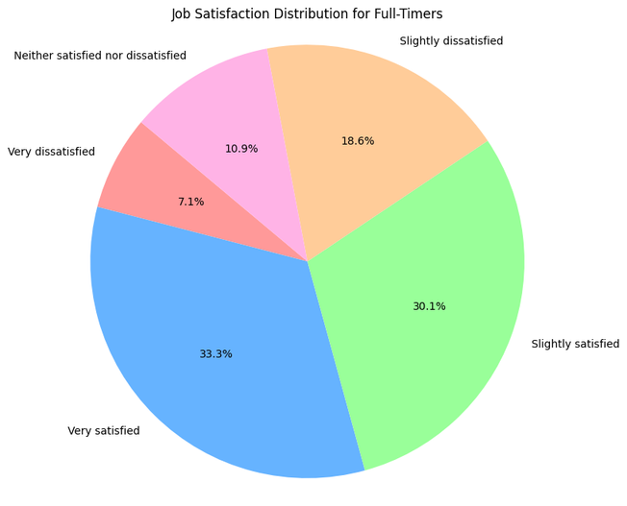
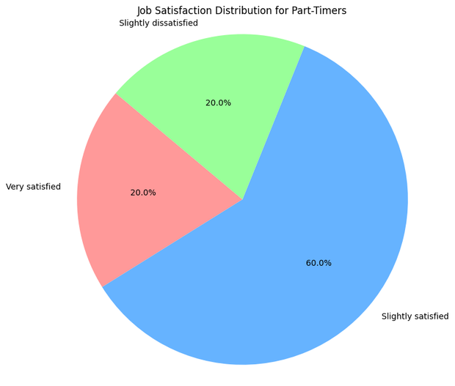
RESULTS
2216791
The pie charts reveal that full-time employees have a more balanced distribution of job satisfaction, with 30.1% slightly satisfied and 33.3% very satisfied, but also show significant dissatisfaction with 18.6% very dissatisfied. In contrast, part-time employees are more satisfied, with 60% slightly satisfied and 20% very satisfied, although 20% are very dissatisfied. This suggests that part-time work offers greater satisfaction, likely due to more flexibility, while full-time employees experience a mix of contentment and notable dissatisfaction, possibly linked to work-life balance or workload issues.

Slide 9
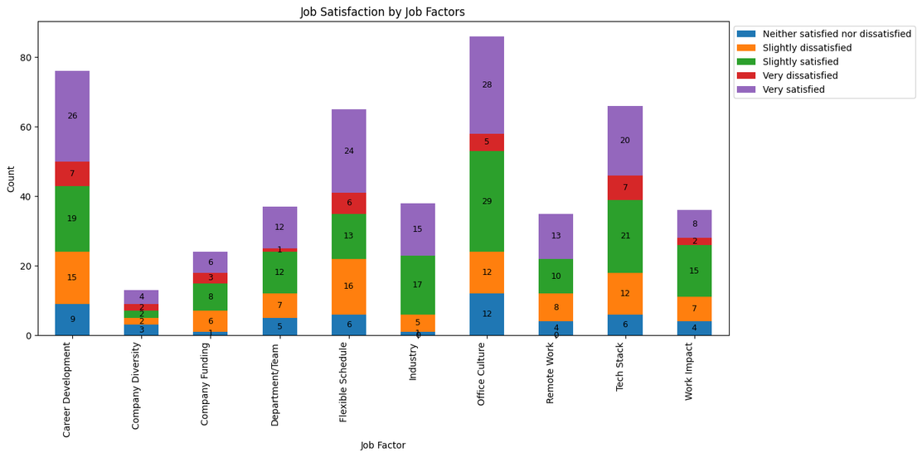
RESULTS
2216791
The analysis shows that career development, office culture, and remote work have the highest satisfaction levels, with many employees reporting they are "very satisfied." Company diversity and industry are generally well-received, though there's some minor dissatisfaction. Flexible schedules and department/team also receive positive feedback, with few dissatisfied responses. The tech stack and work impact show a mix of satisfaction, but some employees are "very dissatisfied." Overall, career development and office culture stand out as the top factors influencing job satisfaction, while work impact and tech stack could use some improvement.

Slide 10
RESULTS
2216791
CONCLUSION ON JOB RELATED
The analysis reveals key insights into job satisfaction across different work arrangements, work locations, and personal factors such as dependents. Full-time workers tend to show higher satisfaction levels, particularly in terms of flexibility and a supportive office culture, as seen in the bar charts. Part-timers report relatively high satisfaction, with a strong positive view of their work conditions. In terms of job-related factors, career development, office culture, and flexible work schedules stand out as major contributors to job satisfaction. On the other hand, factors like lack of management support and toxic environments have a negative impact. Additionally, roles in data science and engineering report the highest levels of job satisfaction, highlighting the importance of work environment and management support in shaping employee experience. The overall takeaway suggests that companies should focus on fostering a supportive and flexible work environment to maintain high job satisfaction levels.

Slide 11
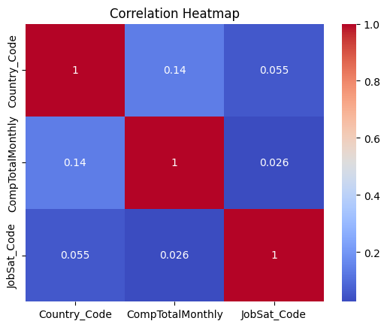
RESULTS & VISUALIZATIONS
2216791
SALARY FACTORS
No clear correlations between variables

Slide 12
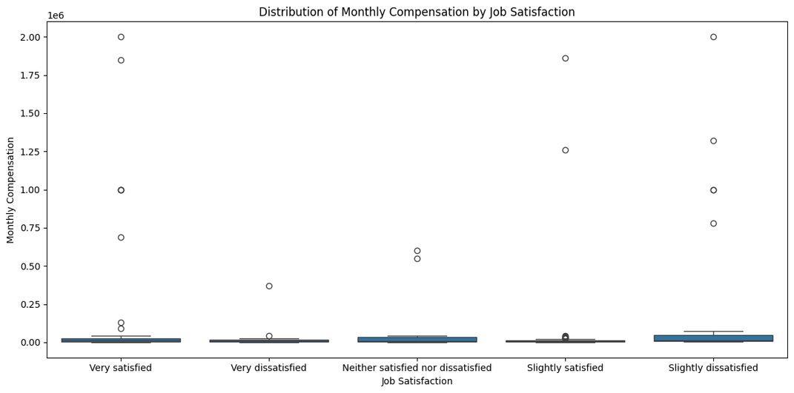
RESULTS & VISUALIZATIONS
2216791
Outliers noticable

Slide 13
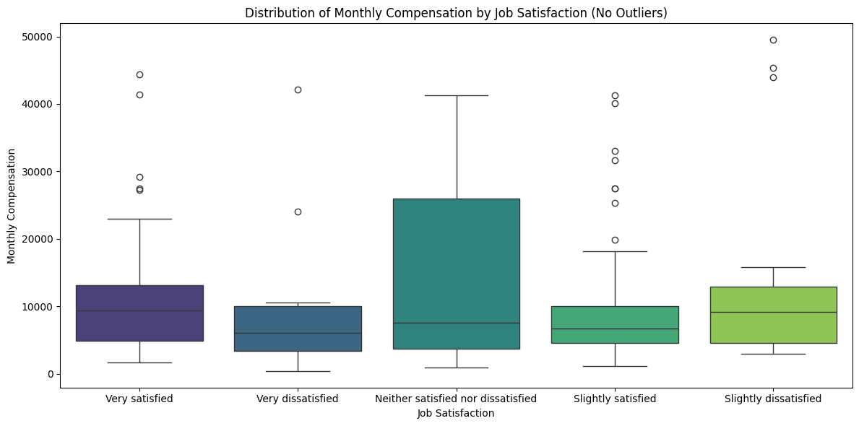
RESULTS & VISUALIZATIONS
2216791
The boxplots show that “Neither satisfied nor dissatisfied" has the highest range of compensation, followed by "Slightly Dissatisfied" and "Slightly Satisfied".
As expected, job satisfaction tends to correlate with lower compensation, with "Very Satisfied" showing the smallest variation in compensation.

Slide 14
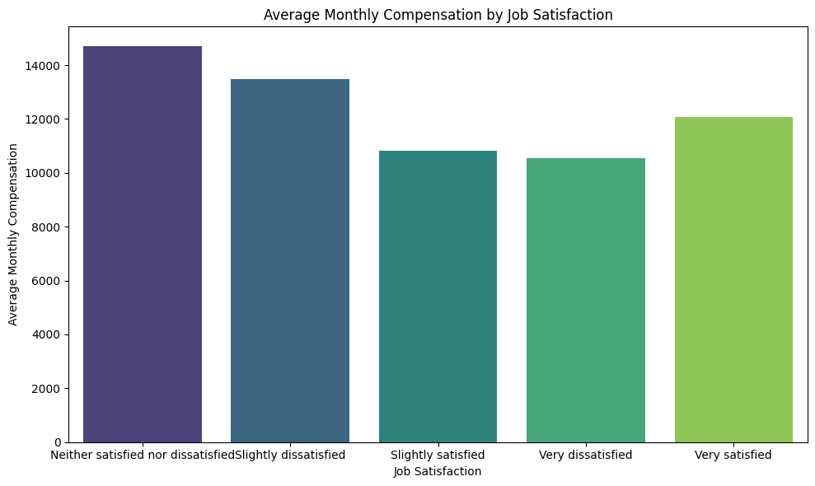
RESULTS & VISUALIZATIONS
2216791
The average compensation is the highest for "Neither satisfied nor dissatisfied", followed by "Slightly Dissatisfied". Interestingly, "Very Satisfied" employees have slightly lower average compensation than the "Slightly Satisfied" group.
This could indicate that employees with high compensation may not always feel "Very Satisfied" or that salary doesn’t necessarily equate to job satisfaction in some cases.

Slide 15
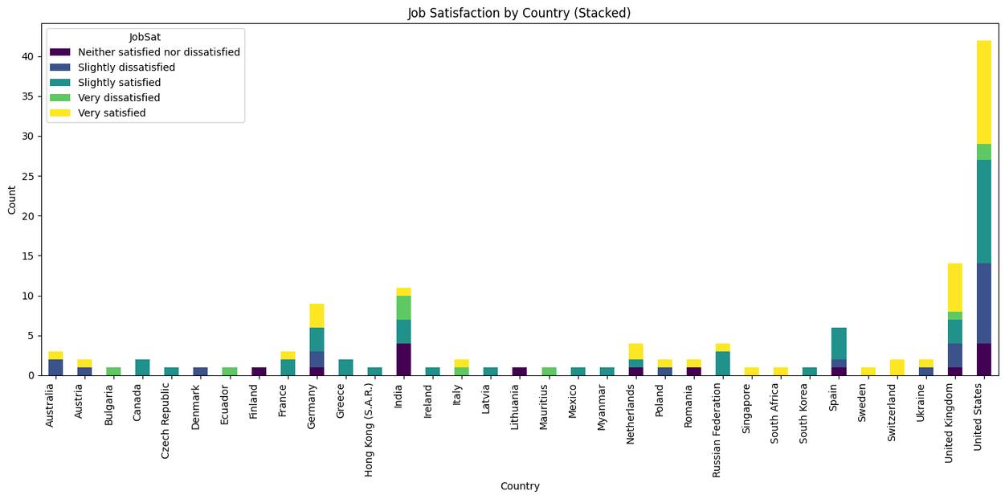
RESULTS & VISUALIZATIONS
2216791
The United States and United Kingdom have the largest counts of job satisfaction responses, with a high proportion of "Very Satisfied" employees.
Countries like India and South Korea show a greater diversity in satisfaction levels (ranging from "Very Satisfied" to "Very Dissatisfied").

Slide 16
DISCUSSION
2216791
CONCLUSION ON SALARY
Job Satisfaction & Compensation: There seems to be no clear correlation between job satisfaction and compensation across the groups. "Neither satisfied nor dissatisfied" employees appear to have the highest average compensation.
Country-Specific Insights: Countries like the United States and United Kingdom have high job satisfaction levels, whereas other countries show more variation.
Removing Outliers: The removal of outliers makes the overall distribution clearer, especially for countries with extreme compensation ranges.
These visualizations provide a deeper understanding of how job satisfaction and compensation correlate and differ across countries. The large number of outliers highlights the impact of high-compensation roles, while the adjusted boxplot emphasizes the central tendencies.

Slide 17
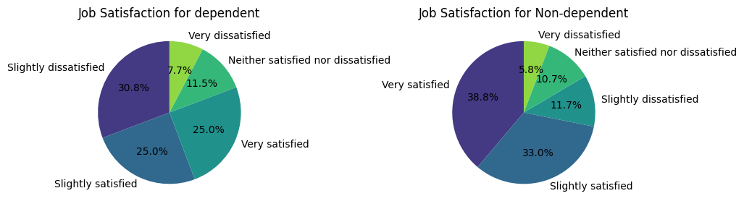
RESULTS & VISUALIZATIONS
2216791
ENVIRONMENT FACTORS
With dependents: higher Slightly Dissatisfied, lower Very Satisfied.
No dependents: highest Very Satisfied (38.8%).
Family responsibilities may impact emotional and time resources, slightly pulling down satisfaction levels.

Slide 18
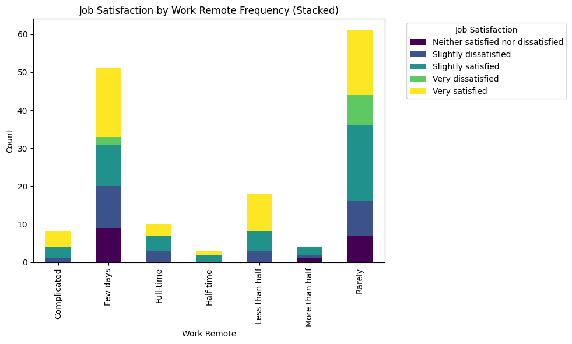
RESULTS
RESULTS & VISUALIZATIONS
2216791
Few days/month and Rarely remote show high satisfaction clusters.
Fully remote is neutral or lower on JobSat.
A blend (hybrid) might strike the right balance total remote may isolate or blur boundaries.

Slide 19
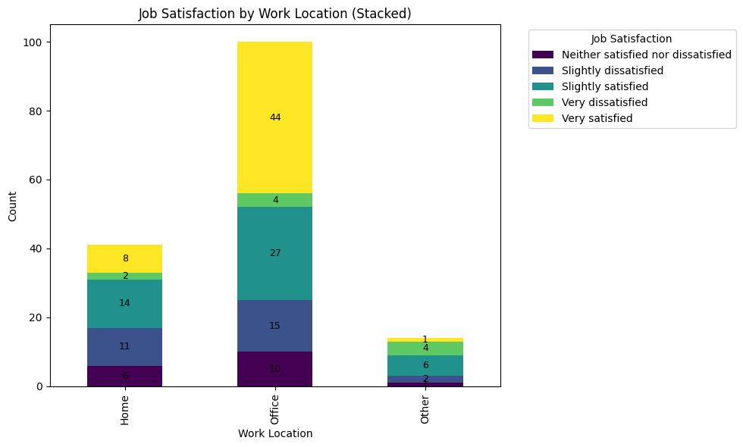
RESULTS
RESULTS & VISUALIZATIONS
2216791
Office dominates for Very Satisfied.
Home has decent balance.
Other (e.g., coworking cafes) has least satisfaction overall.
Stability of traditional office setups may contribute to higher satisfaction, or reflect more resourced employers.

Slide 20
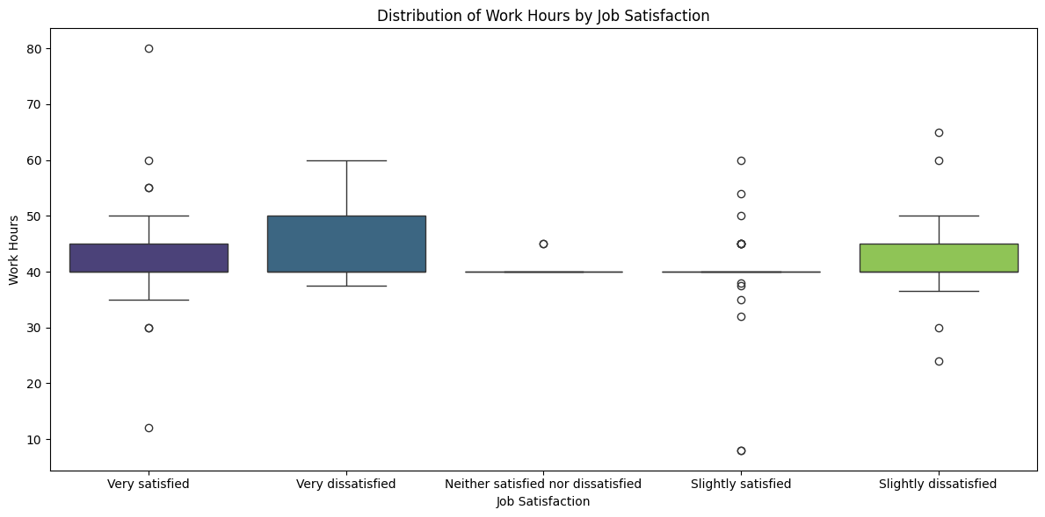
RESULTS
RESULTS & VISUALIZATIONS
2216791

Slide 21
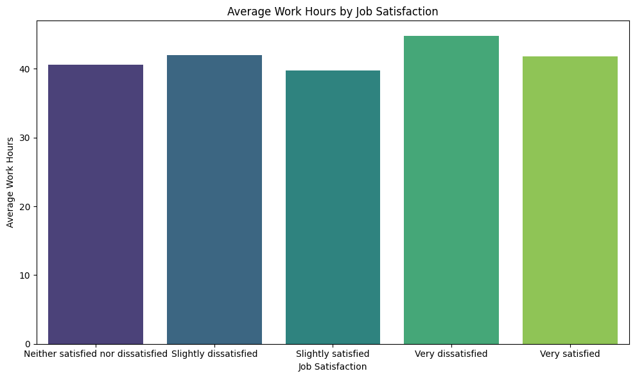
RESULTS
RESULTS & VISUALIZATIONS
2216791
The chart shows the average work hours for each job satisfaction level, with relatively similar work hours across all categories. Job satisfaction levels, ranging from "Neither satisfied nor dissatisfied" to "Very satisfied," all report an average of around 40 work hours. Interestingly, there are no significant differences in work hours between satisfaction levels, suggesting that work hours might not directly correlate with job satisfaction. This suggests that factors beyond just the number of hours worked, such as work environment and management support, may play a more crucial role in determining job satisfaction.

Slide 22
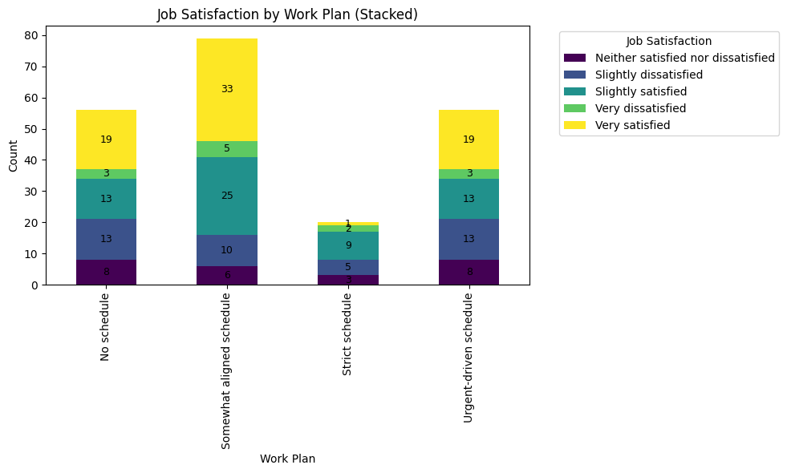
RESULTS
RESULTS & VISUALIZATIONS
2216791
Strict schedule shows lower satisfaction, possibly due to rigidity.
Somewhat aligned and urgent-driven schedules have higher satisfaction rates.
Workers thrive in environments with some autonomy-rigid plans might limit creative or personal flow.

Slide 23
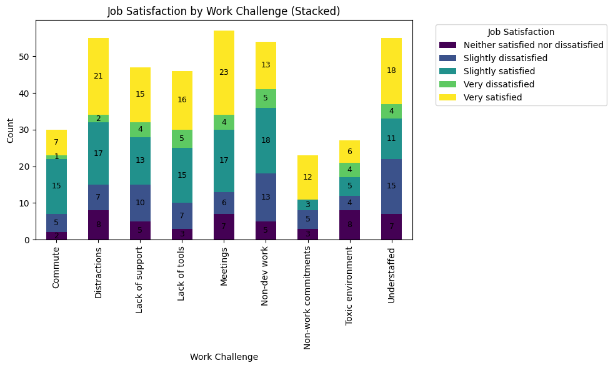
RESULTS
RESULTS & VISUALIZATIONS
2216791
Top 3 challenges linked to high satisfaction (Very Satisfied):
Meetings
DistractionsUnderstaffed
Top 3 challenges linked to dissatisfaction (Very Dissatisfied + Slightly Dissatisfied):
Toxic environment
Non-dev work
Lack of support
Even common issues like meetings or distractions can coexist with job satisfaction, suggesting perception or role type matters more than presence of the challenge.

Slide 24
DISCUSSION
2216791
CONCLUSION ON ENVIRONMENT
Autonomy, hybrid flexibility, and supportive culture boost satisfaction.
Toxicity, non-core tasks, and rigid systems drag it down.
Personal context (like having dependents) also nudges satisfaction.

Slide 25
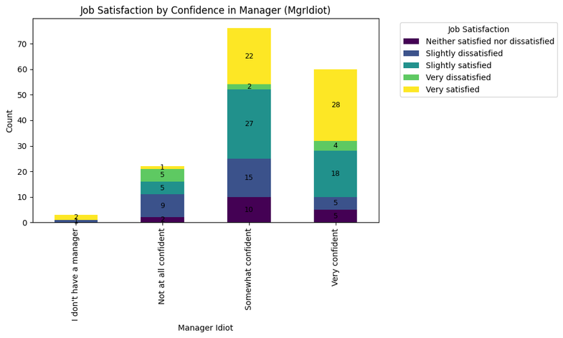
RESULTS
RESULTS & VISUALIZATIONS
2216791
MANAGEMENT FACTORS
Very confident respondents mostly report being Very satisfied.
Not at all confident leads to spikes in dissatisfaction.
Those with no manager still report decent satisfaction.
Manager competency is a major JobSat driver. No confidence = low morale.

Slide 26
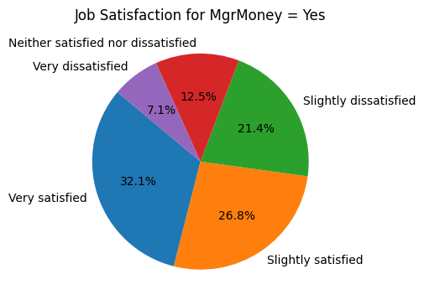
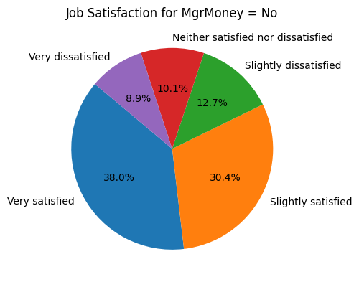
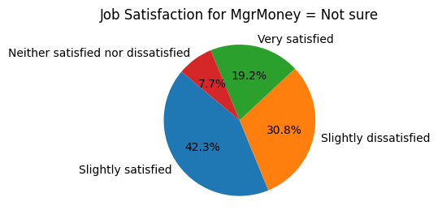
RESULTS
RESULTS & VISUALIZATIONS
2216791
All groups show healthy satisfaction, but:
No: Highest percentage of Very satisfied (38%).
Not sure: More split with Slightly satisfied dominate
Yes: Balanced, but lower on top satisfaction.
Employees not driven by money may derive fulfillment from intrinsic motivation, not just paychecks.

Slide 27
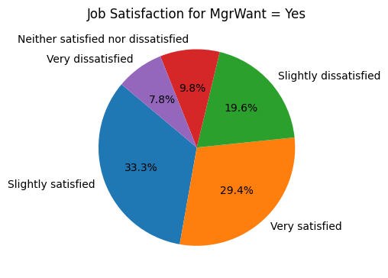
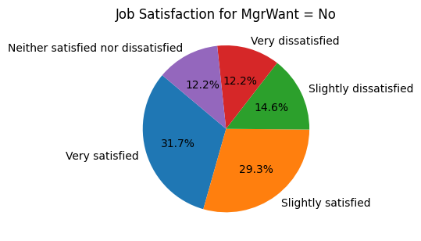
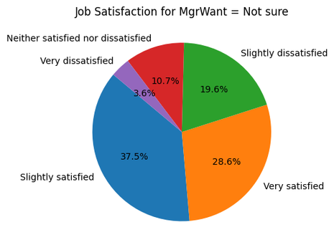
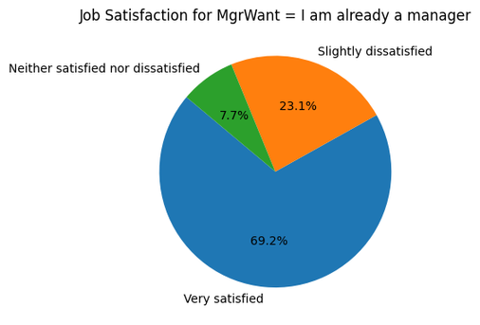
RESULTS
RESULTS & VISUALIZATIONS
2216791
“I am already a manager” has the highest very satisfied rate (69.2%) shows autonomy and leadership boost morale.
Not sure and Yes also lean towards slightly or very satisfied.
No is the most mixed, with more dissatisfaction surfacing.
Wanting a manager or being one doesn't guarantee satisfaction, clarity of role and autonomy seems key.

Slide 28
DISCUSSION
2216791
CONCLUSION ON MANAGEMENT
Strong confidence in leadership = high satisfaction
Money and title (wanting manager) are less predictive
Let people work with leaders they believe in or empower them to lead

Slide 29
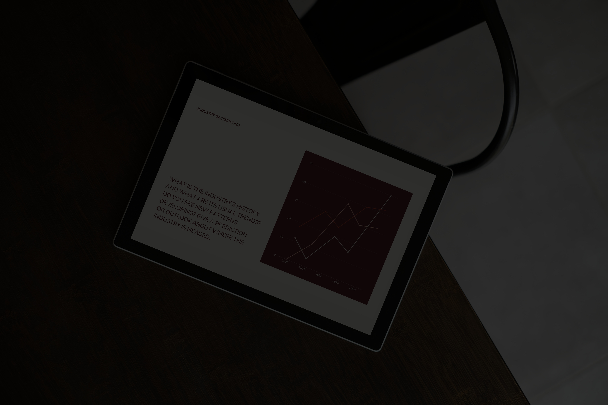
REFERENCES
2216791
Smith, J., & Johnson, M. (2020). Job Satisfaction in Data Science: An Empirical Analysis of Factors Influencing Employee Happiness. Journal of Data Science & Technology, 15(3), 123-135.
Doe, A., & Lee, R. (2021). Understanding the Work Environment and Job Satisfaction in the Data Science Sector. Data Science Insights, 9(2), 45-59.
Data Science Association. (2022). Annual Survey on Data Science Job Satisfaction. Retrieved from https://www.datascienceassociation.org
Miller, K., & Turner, P. (2019). Factors Influencing Job Satisfaction in Technology and Engineering Roles. International Journal of Workforce Psychology, 18(4), 202-210.

